Slide 1
TIME SERIES AND MULTIDIMENSIONAL STREAMING OUTLIER DETECTION
报告人：Jorfun

Slide 2
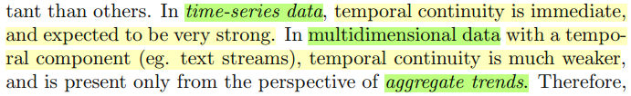
TIME SERIES AND MULTIDIMENSIONAL STREAMING OUTLIER DETECTION
Abrupt Change Detection in Time Series
Outlier Detection in Multidimensional Data Streams
In many cases, the detection of unusual events needs to be performed in a time-critical manner. This is also referred to as streaming outlier detection.

Slide 3
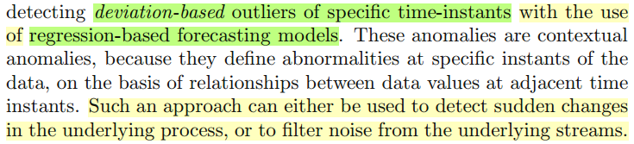
TIME SERIES AND MULTIDIMENSIONAL STREAMING OUTLIER DETECTION
Abrupt Change Detection in Time Series
Prediction-based Outlier Detection of Streaming Time Series
Time-Series of Unusual Shapes
Contextual Anomalies

Slide 4
TIME SERIES AND MULTIDIMENSIONAL STREAMING OUTLIER DETECTION
Abrupt Change Detection in Time Series
Prediction-based Outlier Detection of Streaming Time Series
Time-Series of Unusual Shapes
Temporal continuity plays a significant role, since it is assumed that time-series data values are highly correlated over successive instants, and do not change abruptly.

Slide 5
TIME SERIES AND MULTIDIMENSIONAL STREAMING OUTLIER DETECTION
Abrupt Change Detection in Time Series
Prediction-based Outlier Detection of Streaming Time Series
Autoregressive Models (Correlations across time)
Multiple Time Series Regression Models (Correlations across series)
Supervised Outlier Detection in Time Series
The correlations in a single time-series, or across multiple series, may be used in order to perform the prediction. Thus, two kinds of correlations are used.

Slide 6
TIME SERIES AND MULTIDIMENSIONAL STREAMING OUTLIER DETECTION
Abrupt Change Detection in Time Series
Prediction-based Outlier Detection of Streaming Time Series
Autoregressive Models (Correlations across time)
Multiple Time Series Regression Models (Correlations across series)
Supervised Outlier Detection in Time Series
Autoregressive Models
• Autoregressive models (AR)
• moving average model (MA Model)
• Auto-Regressive Moving Average (ARMA) model
• Autoregressive Integrated Moving Average Model (ARIMA)

Slide 7
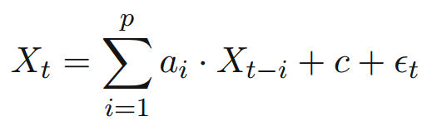
TIME SERIES AND MULTIDIMENSIONAL STREAMING OUTLIER DETECTION
Abrupt Change Detection in Time Series
Prediction-based Outlier Detection of Streaming Time Series
Autoregressive Models (Correlations across time)
• Autoregressive models (AR): The value of Xt is defined in terms of the values in the last window of length p. Particularly useful in the context of univariate time-series.
The value of εt represents the noise, or the deviation from the expected values. Large absolute values of this deviation represent the anomalies in the underlying data.
Extreme value analysis
Notes:
The extreme value analysis techniques of Chapter 2 can be used on εt in order to determine those deviations which vary significantly from the expected values. These values are assumed to be independent and identically distributed random variables, which are drawn from a normal distribution.

Slide 8
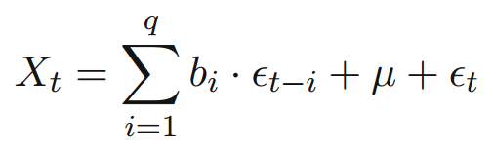
TIME SERIES AND MULTIDIMENSIONAL STREAMING OUTLIER DETECTION
Abrupt Change Detection in Time Series
Prediction-based Outlier Detection of Streaming Time Series
Autoregressive Models (Correlations across time)
• moving average model (MA Model): Predicts subsequent deviations on the basis of the past history of deviations.

Slide 9
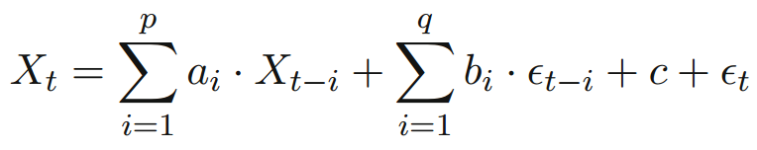
TIME SERIES AND MULTIDIMENSIONAL STREAMING OUTLIER DETECTION
Abrupt Change Detection in Time Series
Prediction-based Outlier Detection of Streaming Time Series
Autoregressive Models (Correlations across time)
• Auto-Regressive Moving Average (ARMA) model: The auto-regressive model can be made more robust by combining it with a moving average model (MA Model). In practice, both the previous history of deviations and values may be important for calculating expected values.

Slide 10
TIME SERIES AND MULTIDIMENSIONAL STREAMING OUTLIER DETECTION
Abrupt Change Detection in Time Series
Prediction-based Outlier Detection of Streaming Time Series
Autoregressive Models (Correlations across time)
• Autoregressive Integrated Moving Average Model (ARIMA): In some cases, the time-series may have some random characteristics, as a result of which it may drift away from the mean.
Underlying statistical structure of the time series evolve with time.
The series can be de-trended by first differencing the time-series before ARMA modeling.

Slide 11
TIME SERIES AND MULTIDIMENSIONAL STREAMING OUTLIER DETECTION
Abrupt Change Detection in Time Series
Prediction-based Outlier Detection of Streaming Time Series
Autoregressive Models (Correlations across time)
Multiple Time Series Regression Models (Correlations across series)
Supervised Outlier Detection in Time Series
Different time series may often contain the same information, and may sometimes contain lag correlations.

Slide 12
TIME SERIES AND MULTIDIMENSIONAL STREAMING OUTLIER DETECTION
Abrupt Change Detection in Time Series
Prediction-based Outlier Detection of Streaming Time Series
Multiple Time Series Regression Models (Correlations across series)
Direct Generalization of Auto-Regressive Models
Principal Component Analysis and Hidden Variable based Models

Slide 13
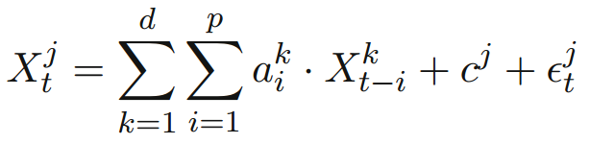
TIME SERIES AND MULTIDIMENSIONAL STREAMING OUTLIER DETECTION
Abrupt Change Detection in Time Series
Prediction-based Outlier Detection of Streaming Time Series
Multiple Time Series Regression Models
Direct Generalization of Auto-Regressive Models
Principal Component Analysis and Hidden Variable based Models
Exponential forgetting mechanism (give more importance to the recent history of the stream)
Speed up the regression process:
Muscles (least squares technique for multivariate regression)
Selective Muscles
Notes:
The normal distribution assumption (or the t-distribution) can be used in order to determine the level of significance of the different anomalies. In general, the values of εjt for a fixed value of of j are assumed to be drawn from a normal or t-distribution.

Slide 14
TIME SERIES AND MULTIDIMENSIONAL STREAMING OUTLIER DETECTION
Abrupt Change Detection in Time Series
Prediction-based Outlier Detection of Streaming Time Series
Multiple Time Series Regression Models
Direct Generalization of Auto-Regressive Models
Principal Component Analysis and Hidden Variable based Models
Dependent-variable analysis can sometimes be very sensitive to the presence of noise and outliers.
Global directions of correlation such as PCA, which are not optimized to any particular variable, are usually much more robust to the presence of outliers. Such analysis leads to a set of hidden variables, which can be used in order to generate all variables in the stream simultaneously (使用hidden variables来把流的所有时间戳上的variable都同时预测出来).

Slide 15
TIME SERIES AND MULTIDIMENSIONAL STREAMING OUTLIER DETECTION
Abrupt Change Detection in Time Series
Prediction-based Outlier Detection of Streaming Time Series
Multiple Time Series Regression Models
Direct Generalization of Auto-Regressive Models
Principal Component Analysis and Hidden Variable based Models
The PCA method can be generalized to window-based analysis, by using a window of length p in order to create the covariance matrix.
The eigenvectors of this covariance matrix provide a generative model for the values in the data stream. Significant deviations from this model represent deviations in the underlying data stream.

Slide 16
TIME SERIES AND MULTIDIMENSIONAL STREAMING OUTLIER DETECTION
Abrupt Change Detection in Time Series
Prediction-based Outlier Detection of Streaming Time Series
Multiple Time Series Regression Models
Direct Generalization of Auto-Regressive Models
Principal Component Analysis and Hidden Variable based Models
过度的偏离值虽说代表着异常事件，但并不清楚具体是由什么引起的异常，我们感兴趣的异常可能会混在一些虚假的（我们不感兴趣的）异常之中。
So how does one distinguish between noise and true anomalies, which are of interest to the analyst? The time-tested method for making the approach more sensitive to analyst interest, is to use supervision from previous examples.

Slide 17
TIME SERIES AND MULTIDIMENSIONAL STREAMING OUTLIER DETECTION
Abrupt Change Detection in Time Series
Prediction-based Outlier Detection of Streaming Time Series
Autoregressive Models (Correlations across time)
Multiple Time Series Regression Models (Correlations across series)
Supervised Outlier Detection in Time Series
Supervision can be very helpful in distinguishing the true anomalies from the spurious abnormalities in the time series data stream.
Example: Multivariate scenario. Create a composite alarm level from the error terms in the time series prediction.

Slide 18
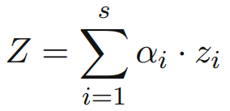
TIME SERIES AND MULTIDIMENSIONAL STREAMING OUTLIER DETECTION
Abrupt Change Detection in Time Series
Prediction-based Outlier Detection of Streaming Time Series
Autoregressive Models (Correlations across time)
Multiple Time Series Regression Models (Correlations across series)
Supervised Outlier Detection in Time Series
根据前面univariate time-series prediction model得到在某一时间戳上，所有stream都有的一个与之对应的error term。通过规范化处理将它们转换为Z-value。然后根据ground truth events of interest的偏离情况来对不符合的值进行剪枝（剔除掉即不可能属于primary abnormal也不属于secondary abnormal的情况，这些值不可能会是我们想要找的异常）。之后我们要找到合适α值来对剪枝后的这些值里面的primary和secondary events（标签预先就有的）做出最好的区分（产生相差最大的composite alarm level）。
在实际应用中，就可以根据这些α值来对当前时间戳的情况计算出composite alarm level然后把它作为相应的异常分数，或者根据预先设定的阈值来判断是否为异常。

Slide 19
TIME SERIES AND MULTIDIMENSIONAL STREAMING OUTLIER DETECTION
Abrupt Change Detection in Time Series
Prediction-based Outlier Detection of Streaming Time Series
Time-Series of Unusual Shapes

Slide 20
TIME SERIES AND MULTIDIMENSIONAL STREAMING OUTLIER DETECTION
Abrupt Change Detection in Time Series
Time-Series of Unusual Shapes
Transformation to Other Representations
Distance-based Methods
Finding Unusual Shapes from Multivariate Series
Supervised Methods for Finding Unusual Time-Series Shapes

Slide 21
TIME SERIES AND MULTIDIMENSIONAL STREAMING OUTLIER DETECTION
Abrupt Change Detection in Time Series
Time-Series of Unusual Shapes
Transformation to Other Representations
Numeric Multidimensional Transformations
Discrete Sequence Transformations
The series (or each subsequence of the series) is transformed into a multidimensional vector. The representation of each dimension corresponds to numeric coefficients in standard vector space. Proximity can be computed on this representation with the Euclidean distance.
Consider each window of length n in the time-series as a multidimensional vector of length n.
Other methods such as Discrete Wavelet Transform (DWT) and Fast Fourier Transform are available for compressing the series with the multi-scale approach into numeric coefficients.

Slide 22
TIME SERIES AND MULTIDIMENSIONAL STREAMING OUTLIER DETECTION
Abrupt Change Detection in Time Series
Time-Series of Unusual Shapes
Transformation to Other Representations
Numeric Multidimensional Transformations
Discrete Sequence Transformations
The series can be transformed to symbolic representations by using discretization methods.
(symbolically discretized representations of) the means over specific windows, slopes over specific windows, discrete wavelet coefficients, and Fourier transform coefficients
Symbolic Aggregate Approximation (SAX)
symbolic discretization does lose a significant amount of information about the underlying time-series. Such approximations are useful in streaming scenarios because of their simplicity and ease in construction.

Slide 23
TIME SERIES AND MULTIDIMENSIONAL STREAMING OUTLIER DETECTION
Abrupt Change Detection in Time Series
Time-Series of Unusual Shapes
Transformation to Other Representations
Distance-based Methods
Finding Unusual Shapes from Multivariate Series
Supervised Methods for Finding Unusual Time-Series Shapes

Slide 24
TIME SERIES AND MULTIDIMENSIONAL STREAMING OUTLIER DETECTION
Abrupt Change Detection in Time Series
Time-Series of Unusual Shapes
Distance-based Methods
Euclidean distances, Dynamic Time Warping
HOT-SAX (Heuristically Ordered Time series using Symbolic Aggregate Approximation)
The discretized versions of time series discussed in the last section are often used for scenarios where quick approximations are needed for pruning purposes, and the anomaly scores are computed on the basis of the original numeric representations.
The SAX representation is used in order to provide a good ordering of candidates for outliers, as well the ordering in which to iteratively compute the nearest neighbor distance for a candidate.

Slide 25
TIME SERIES AND MULTIDIMENSIONAL STREAMING OUTLIER DETECTION
Abrupt Change Detection in Time Series
Time-Series of Unusual Shapes
Transformation to Other Representations
Distance-based Methods
Finding Unusual Shapes from Multivariate Series
Supervised Methods for Finding Unusual Time-Series Shapes

Slide 26
TIME SERIES AND MULTIDIMENSIONAL STREAMING OUTLIER DETECTION
Abrupt Change Detection in Time Series
Time-Series of Unusual Shapes
Finding Unusual Shapes from Multivariate Series
multivariate series
Different behavioral attributes such as temperature, pressure or the same behavioral attribute such as the temperature may be measured at the same instant by different sensors.
trajectory outlier detection

Slide 27
TIME SERIES AND MULTIDIMENSIONAL STREAMING OUTLIER DETECTION
Abrupt Change Detection in Time Series
Time-Series of Unusual Shapes
Finding Unusual Shapes from Multivariate Series
Even though the existing work has been designed for spatial trajectories, it can also be extended to the non-spatial case with arbitrary values on the X-coordinates and Y -coordinates.
In this case, it is possible to visualize the variation of the two behavioral attributes by eliminating the common time attribute, or by creating a 3-dimensional trajectory containing the time and the other two behavioral attributes.

Slide 28
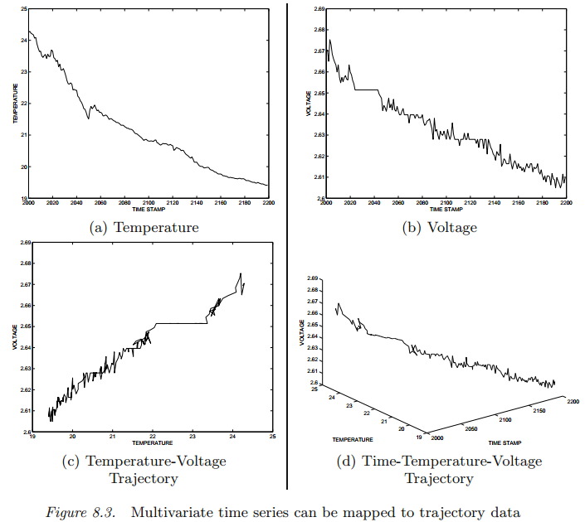
TIME SERIES AND MULTIDIMENSIONAL STREAMING OUTLIER DETECTION

Slide 29
TIME SERIES AND MULTIDIMENSIONAL STREAMING OUTLIER DETECTION
Abrupt Change Detection in Time Series
Time-Series of Unusual Shapes
Finding Unusual Shapes from Multivariate Series
The curse of dimensionality
In such cases, it may be better to explore subsets of behavioral attributes in order to determine outliers.

Slide 30
TIME SERIES AND MULTIDIMENSIONAL STREAMING OUTLIER DETECTION
Abrupt Change Detection in Time Series
Time-Series of Unusual Shapes
Transformation to Other Representations
Distance-based Methods
Finding Unusual Shapes from Multivariate Series
Supervised Methods for Finding Unusual Time-Series Shapes

Slide 31
TIME SERIES AND MULTIDIMENSIONAL STREAMING OUTLIER DETECTION
Abrupt Change Detection in Time Series
Time-Series of Unusual Shapes
Supervised Methods for Finding Unusual Time-Series Shapes
In many medical applications, characteristic pathological properties may be captured by unusual shapes of the underlying time series. In such cases, training data is often available about either the normal or the pathological behavior or both. Thus, such an approach requires the detection of unusual shapes in time series in a supervised manner.

Slide 32
TIME SERIES AND MULTIDIMENSIONAL STREAMING OUTLIER DETECTION
Abrupt Change Detection in Time Series
Time-Series of Unusual Shapes
Supervised Methods for Finding Unusual Time-Series Shapes
The simplest possible approach in such a scenario is develop subsequence profiles for both the normal class and the anomalous class.
For a given test subsequence, a k-nearest neighbor approach may be used for classification purposes.

Slide 33
TIME SERIES AND MULTIDIMENSIONAL STREAMING OUTLIER DETECTION
Abrupt Change Detection in Time Series
Time-Series of Unusual Shapes
Supervised Methods for Finding Unusual Time-Series Shapes
Feature extraction and transformation forms the core of all supervised methods for time series classification.
Transform the series to a discrete representation, and then use Hidden Markov Models (HMM) for the purposes of classification. (create a generative model which is specific to each class. For a given test sequence, the evaluation algorithm is used to determine the identity of the best fit class)
Mine shapelets from the data, which are highly discriminative features for classification purposes.

Slide 34
TIME SERIES AND MULTIDIMENSIONAL STREAMING OUTLIER DETECTION
Abrupt Change Detection in Time Series
Outlier Detection in Multidimensional Data Streams
Each record contains d-dimensions which form an indivisible unit. Temporal continuity is much weaker than the case of time-series.
In the context of multidimensional data streams, efficiency is a core concern, because the outliers need to be discovered quickly.

Slide 35
TIME SERIES AND MULTIDIMENSIONAL STREAMING OUTLIER DETECTION
Outlier Detection in Multidimensional Data Streams
Individual Data Points as Outliers
Aggregate Change Points as Outliers
Rare and Novel Class Detection in Multidimensional Data Streams (supervised streaming scenario)
Novelty: Outlier detection of individual records. A first news story on a specific topic represents an outlier of this type.
Change point: Changes in the aggregate trends of the multidimensional data. An unusual event such as a terrorist attack may lead to a burst of news stories on a specific topic. This essentially represents a higher level and aggregated outlier based on a specific time window.

Slide 36
TIME SERIES AND MULTIDIMENSIONAL STREAMING OUTLIER DETECTION
Outlier Detection in Multidimensional Data Streams
Individual Data Points as Outliers
Aggregate Change Points as Outliers
Rare and Novel Class Detection in Multidimensional Data Streams (supervised streaming scenario)

Slide 37
TIME SERIES AND MULTIDIMENSIONAL STREAMING OUTLIER DETECTION
Outlier Detection in Multidimensional Data Streams
Individual Data Points as Outliers
Proximity-based Algorithms
Probabilistic Algorithms
High-dimensional Scenario
Closely related to the problem of unsupervised novelty detection, especially when the entire history of the data stream is used.
first story detection
The traditional approach to first story detection is to represent documents as vectors in term space, where coordinates represent the (possibly IDF-weighted) frequency of a particular term in a document. Each new document is then compared to the previous ones, and if its similarity to the closest document (or centroid) is below a certain threshold, the new document is declared to be a first story.

Slide 38
TIME SERIES AND MULTIDIMENSIONAL STREAMING OUTLIER DETECTION
Outlier Detection in Multidimensional Data Streams
Individual Data Points as Outliers
Proximity-based Algorithms
distance-based definition of outliers: The outlier score of a data point is defined in terms of its k-nearest neighbor distance to data points in a time window of length W (incremental scenario)
distance-based method: STORM algorithm, LOF algorithm
Many of the aforementioned methods are still quite computationally expensive in the context of the data stream.
The complexity of the outlier detection process can be greatly improved by using a clustering-based approach. (not advisable, when the number of data points is limited)
Notes:
when an incoming data point does not lie within a specified statistical radius of the existing clusters in the data. Such data points may be considered outliers.

Slide 39
TIME SERIES AND MULTIDIMENSIONAL STREAMING OUTLIER DETECTION
Outlier Detection in Multidimensional Data Streams
Individual Data Points as Outliers
Probabilistic Algorithms
The clustering approach discussed above can also be used in the context of probabilistic learning algorithms. (GMM)
A method in [478] proposes methods for creating mixture models from mixed attribute data sets. The idea is to compute a fit of the incoming data point to the model both before and after the data point is added to the model.

Slide 40
TIME SERIES AND MULTIDIMENSIONAL STREAMING OUTLIER DETECTION
Outlier Detection in Multidimensional Data Streams
Individual Data Points as Outliers
High-dimensional Scenario
The combination of the stream scenario and high dimensional data is particularly challenging because of the complexity of high dimensional projected clustering algorithms.
Many of the high dimensional projected stream clustering algorithms can also be used in order to determine anomalies in the data stream. This is because many of these algorithms report outliers as side products of the clustering algorithm [6, 111]. Data points which start new clusters in the stream can typically be reported as outliers.
Notes:
projected clustering: which can determine clusters for a specific subset of dimensions.

Slide 41
TIME SERIES AND MULTIDIMENSIONAL STREAMING OUTLIER DETECTION
Outlier Detection in Multidimensional Data Streams
Individual Data Points as Outliers
Aggregate Change Points as Outliers
Rare and Novel Class Detection in Multidimensional Data Streams (supervised streaming scenario)
Changes in the aggregate trends of the multidimensional data.
For example, an unusual event such as a terrorist attack may lead to a burst of news stories on a specific topic. This essentially represents a higher level and aggregated outlier based on a specific time window.

Slide 42
TIME SERIES AND MULTIDIMENSIONAL STREAMING OUTLIER DETECTION
Outlier Detection in Multidimensional Data Streams
Aggregate Change Points as Outliers
Velocity Density Estimation Method
Statistically Significant Changes in Aggregate Distributions

Slide 43
TIME SERIES AND MULTIDIMENSIONAL STREAMING OUTLIER DETECTION
Outlier Detection in Multidimensional Data Streams
Aggregate Change Points as Outliers
Velocity Density Estimation Method
The idea in velocity density is to construct a density based velocity profile of the data. This is analogous to the concept of kernel density estimation in static data sets.
The idea in velocity density estimation is to estimate the rate at which the changes in the data density are occurring at each spatial location based on some user-defined temporal window h_{t}.

Slide 44
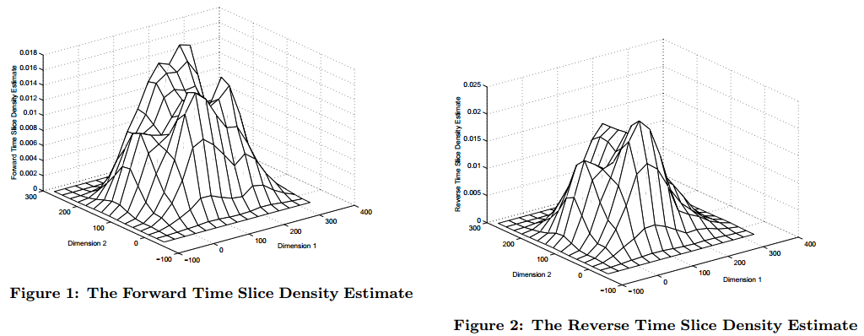
TIME SERIES AND MULTIDIMENSIONAL STREAMING OUTLIER DETECTION

Slide 45
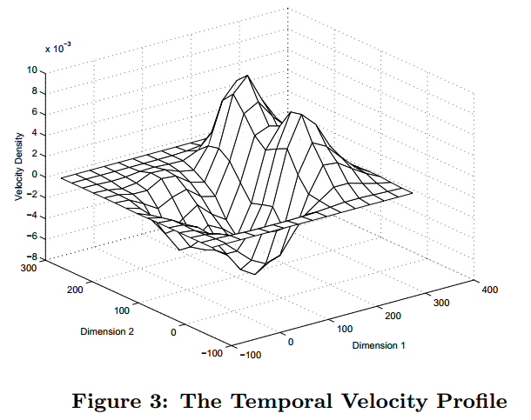
TIME SERIES AND MULTIDIMENSIONAL STREAMING OUTLIER DETECTION

Slide 46
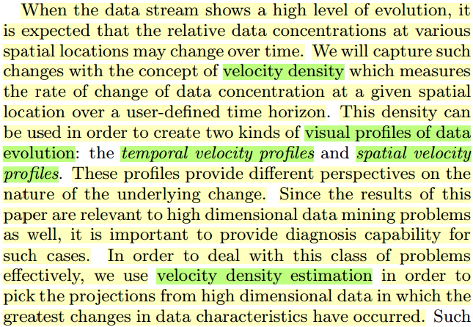
TIME SERIES AND MULTIDIMENSIONAL STREAMING OUTLIER DETECTION

Slide 47
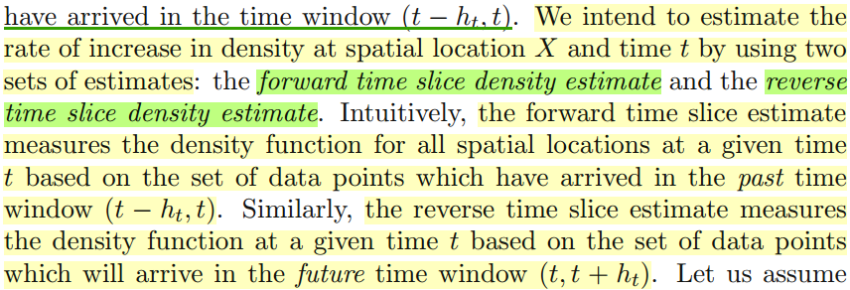
TIME SERIES AND MULTIDIMENSIONAL STREAMING OUTLIER DETECTION

Slide 48
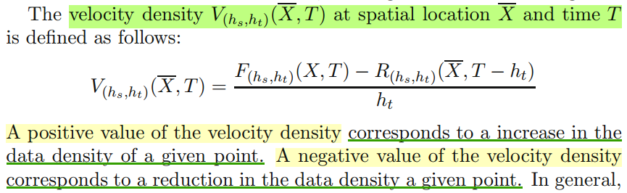
TIME SERIES AND MULTIDIMENSIONAL STREAMING OUTLIER DETECTION

Slide 49
TIME SERIES AND MULTIDIMENSIONAL STREAMING OUTLIER DETECTION
Outlier Detection in Multidimensional Data Streams
Aggregate Change Points as Outliers
Statistically Significant Changes in Aggregate Distributions
A different way to characterizing aggregate changes in multidimensional data streams would be to estimate the aggregate distributions in these time windows. Significant changes in these time windows can be reported as the unusual changes in the data stream.

Slide 50
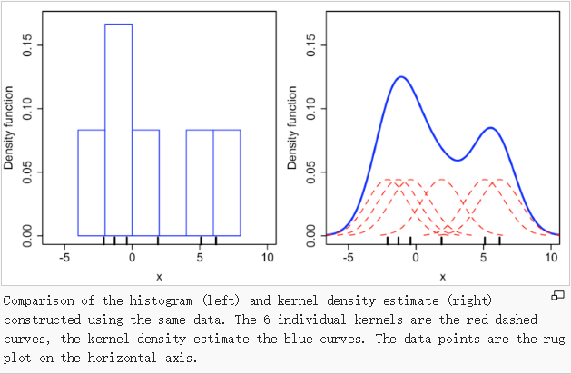
TIME SERIES AND MULTIDIMENSIONAL STREAMING OUTLIER DETECTION
Velocity-density method: Estimates the aggregate distributions with the use of kernel-density estimation.
This method: In the context of change detection, it is also sometimes useful to be able to perform statistical tests directly on the underlying distributions in order to determine significant change points.

Slide 51
TIME SERIES AND MULTIDIMENSIONAL STREAMING OUTLIER DETECTION
Outlier Detection in Multidimensional Data Streams
Aggregate Change Points as Outliers
Statistically Significant Changes in Aggregate Distributions
One example: Since change detection is essentially relevant to the concept of finding distances between distributions, a very general way of representing this distance is the relative entropy from information theory. This is also known as the Kullback-Leibler (or KL) distance.

Slide 52
TIME SERIES AND MULTIDIMENSIONAL STREAMING OUTLIER DETECTION
Outlier Detection in Multidimensional Data Streams
Individual Data Points as Outliers
Aggregate Change Points as Outliers
Rare and Novel Class Detection in Multidimensional Data Streams (supervised streaming scenario)
Rare Class Outliers
Novel Class Outliers: These are classes, which were not encountered before in the data stream.
Infrequently Recurring Class Outliers: These are classes, which have not been encountered for a while, but may re-appear in the stream. Such classes are different from the first type of outliers, because they arrive in temporally rare bursts.

Slide 53
TIME SERIES AND MULTIDIMENSIONAL STREAMING OUTLIER DETECTION
Outlier Detection in Multidimensional Data Streams
Rare and Novel Class Detection in Multidimensional Data Streams (supervised streaming scenario)
Detecting Rare Classes
In such cases, a small fraction of the records may belong to a rare class, but they may not necessarily be distributed in a non-homogenous way from a temporal perspective.
Numerous classifiers are available for the streaming scenario [10], especially in the presence of concept drift. For detecting rare classes, the only change to be made to these classifiers is to add methods which are intended to handle the class imbalance.

Slide 54
TIME SERIES AND MULTIDIMENSIONAL STREAMING OUTLIER DETECTION
Outlier Detection in Multidimensional Data Streams
Rare and Novel Class Detection in Multidimensional Data Streams (supervised streaming scenario)
Detecting Novel Classes
Novel class detection in the online setting.
Detecting novel classes is also a form of semi-supervision, because models are available about many of the other classes, but not the class that is being detected.
A more general way of understanding the novel class detection problem is to view it as a combination of supervised (classification) and unsupervised (clustering) models.

Slide 55
TIME SERIES AND MULTIDIMENSIONAL STREAMING OUTLIER DETECTION
Maintaining a supervised model of the classes available in the training data as an ensemble of classification models.
Maintaining an unsupervised model of the (unlabeled) novel classes received so far as cohesive groups of tightly knit clusters.
When a new test instance is received, the classification model is first applied to it to test whether it belongs to a currently existing (labeled) class. If this is not the case, it is tested whether it naturally belongs to one of the novel classes.
If neither of these conditions hold, it is assumed that the new data point should be in a novel class of its own.

Slide 56
TIME SERIES AND MULTIDIMENSIONAL STREAMING OUTLIER DETECTION
Outlier Detection in Multidimensional Data Streams
Rare and Novel Class Detection in Multidimensional Data Streams (supervised streaming scenario)
Detecting Infrequently Recurring Classes
简化的方法：one solution is to simply report a recurring outlier as a novel outlier
By remembering the distribution of the recurring class over time, it is possible to improve the classification accuracy.

Slide 57
感谢聆听

